Slide 1
Crude Oil Price Prediction using Artificial Neural Networks (ANNs)
Group 8: Eduardo Armenta, Tegveer Ghura, Tingsong Li

Slide 2
Agenda
Paper intro
Data and variables
Model
Results
Experiment replication
Results comparison
Conclusion
Questions and comments

Slide 3
Introduction to Research Paper
“Crude Oil Price Prediction using Artificial Neural Networks”
Data dates from January 2014 to November 2019
Fit the training data into ANN model
Results yielded an incredibly accurate model
Data collection
Split data
Develop ANN model
Selection and training parameter
Training model
Calculation of errors
ANN models

Slide 4
Data and Variables
Data is a time series
Using testing data to find lag with lowest RMSE
Varying lag values and training model to find optimal results
Or ANN, paper is inconsistent
Lag of 3 yielded the best predictions
LAG | RMSE VALUE
2 | 10.23
3 | 7.68
4 | 8.50
5 | 9.71

Slide 5
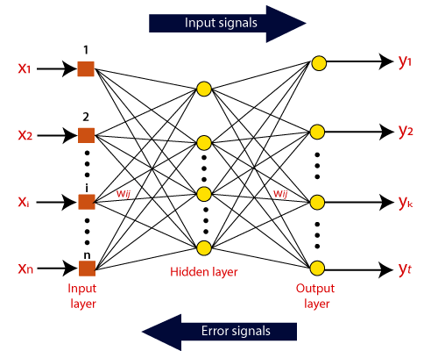
Model
ANN model
Inspired by the human brain
Input layer receives data to be analyzed
Hidden layers process the data through backpropagation and transform the data into meaningful representations
Output layer produces the predictions
Weights determine the strength of the connections between perceptrons

Slide 6
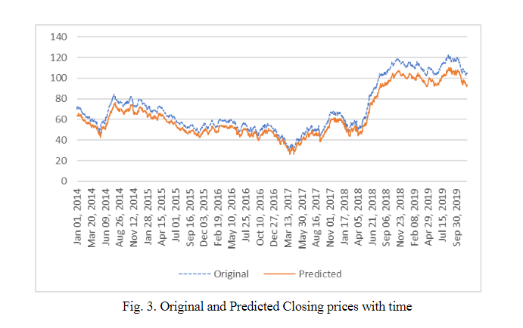
Results
ANN model with a lag of 3 units predicts the crude oil prices unbelievably well
Predictions look like original data with a small variation
Lack of documentation and theoretical know-how make us doubt these results

Slide 7





Seeds of Doubt
Didn’t include a repo to access the code used to create the model
There is no link to the data and no way to confirm it’s correct
Didn’t impute dates; about 600 rows of data were missing
Utilized wrong activation function for a numerical output
Didn’t include units for price data, lags, and other similar mistakes

Slide 8



Our Notebook
In an attempt to understand their work, we decided to recreate their process (with the limited information we could decipher from their paper).
Data
A time series of the daily closing prices of crude oil barrels in dollars
Variables
The data itself and an optimal time lag (3) on each closing price
Models
ANN in R and Python; varying layers and optimizers
Results
Forecasted on train & test data, concatenated for full data

Slide 9
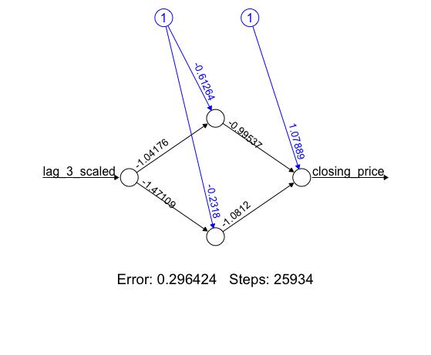
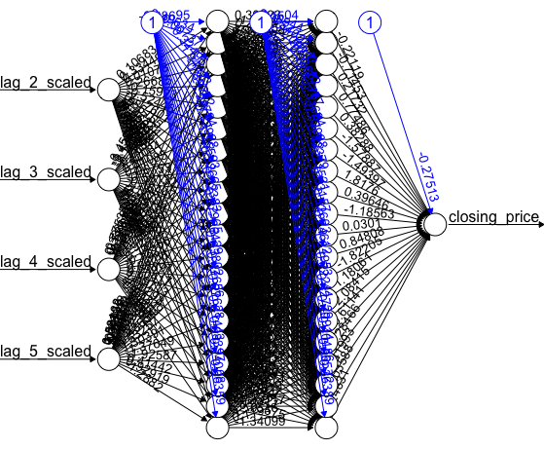
Our Model in R
We tuned the number of hidden layers as well as lag inputs to spot differences in the predicted prices. However, a simple model with 1 hidden layer comprising 2 nodes did as well as a complex model with 2 hidden layers comprising 20 nodes each, given the same set of inputs!
Package: neuralnet
Softplus as activation function: Mitigates vanishing gradient problem
Minimum Partial Derivative Threshold of 0.1
Backpropagation and Stochastic Gradient Descent to update weights
Learning rate (𝞰): 1x10⁻⁵

Slide 10
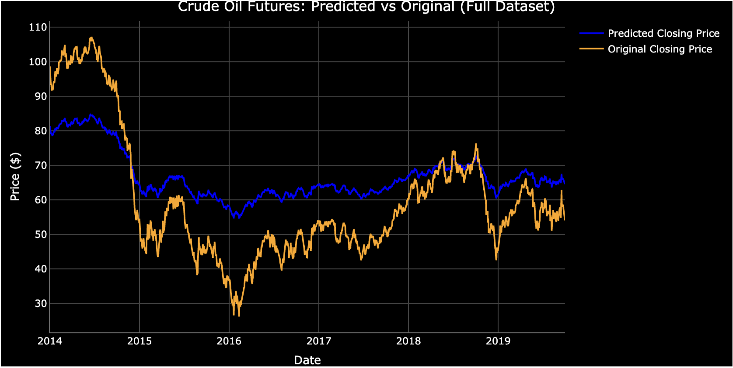
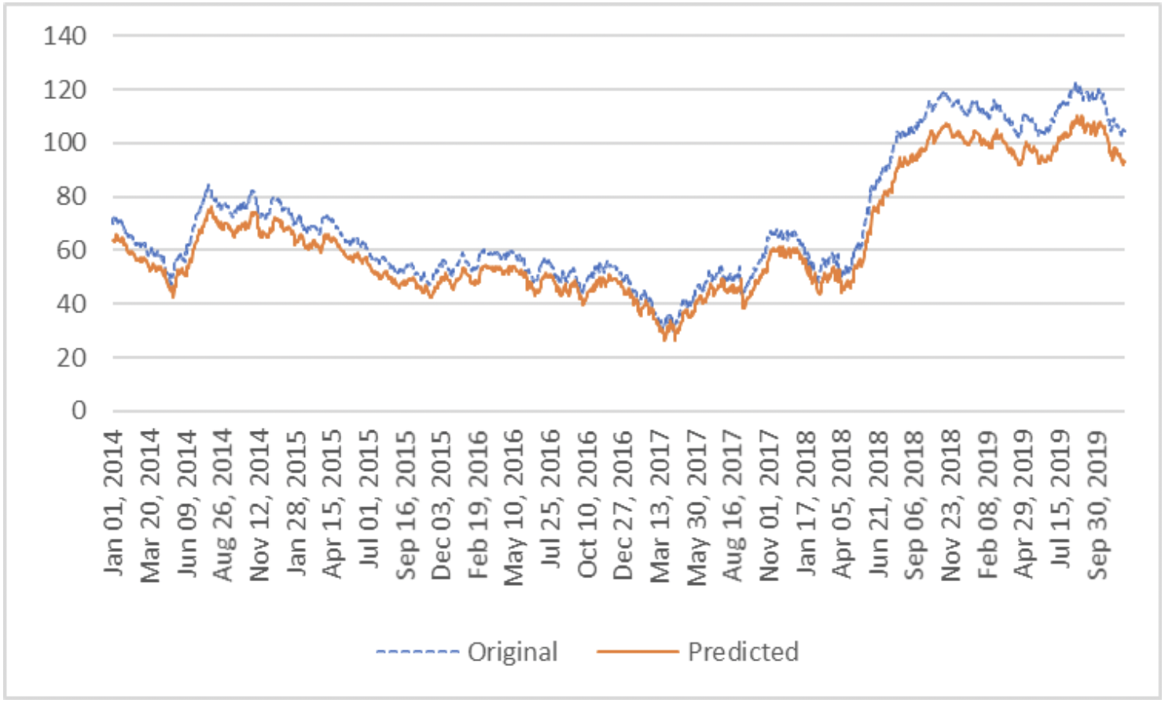
Comparing Results
Our ANN model (bottom) has more realistic results for price prediction
With only a time series as data, models employed in this domain, such as SARIMA and ARCH/GARCH models, might be able to capture the highly volatile series.
In terms of neural networks, RNNs, such as LSTMs, could be employed.

Slide 11
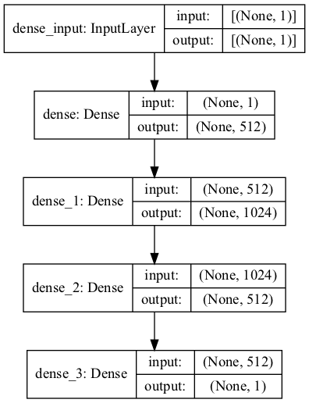
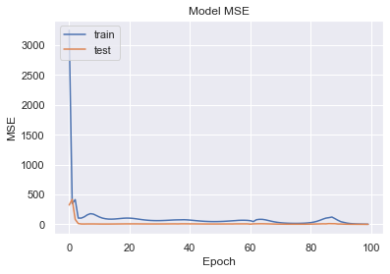
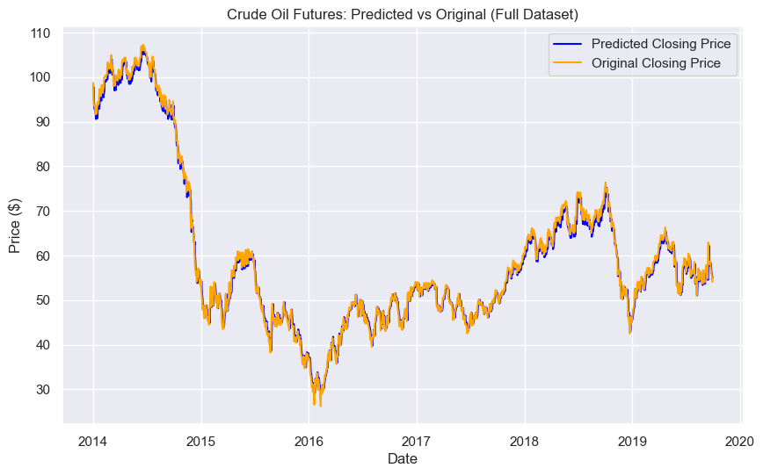
Our Model in Python & Results
Only Lag 3 as input
3 Hidden Layers with 512, 1024, 512 nodes respectively
Relu activation function
No regularization
Adam optimizer with a learning rate (𝞰) of 1x10⁻⁴
Trained on 100 epochs with a batch size of 32 (random and sequential) and validation set of 20% of training data

Slide 12
Conclusion
When writing articles like this, we must provide a way to repeat our work. Otherwise, doubt can be cast on our results and others will struggle to prove it right or wrong
Neural networks are best used with the appropriate activation functions. Make sure you understand the problem and desired prediction before selecting your function.
As taught in 501, make sure to name the units of your values. A lag of 3 could mean mins, days, weeks, etc. The price could be in any currency. Avoid confusion by adding units.

Slide 13


Links for Reference
Access the following links for the code, data, and slide deck of our study:
Repo
Data

Slide 14
Questions or comments?

Slide 15
Thanks!

